Slide 1
Our Commitments for Dementia
in Sheffield: have your say

Slide 2
Dementia in Sheffield
It is estimated that there are over
7,000 people living with dementia
in Sheffield. That’s over 1% of the population.
On average, a person can live with dementia for 10 to 15 years.
This means dementia is an increasingly important factor in relation to how long we can expect to live in good health.

Slide 3
What is dementia?
The word ‘dementia’ describes a
set of symptoms that may include:
memory loss
difficulties with thinking, problem-solving or language
changes in mood or behaviour
The specific symptoms that someone with dementia experiences will depend on the parts of the brain that are affected and the disease that is causing the dementia.

Slide 4
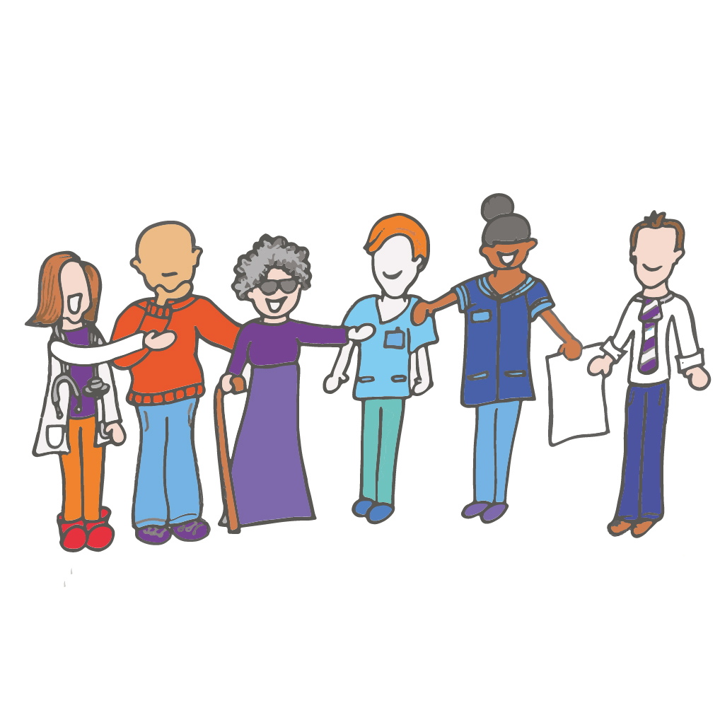
How these commitments have been made
Inspired by the ‘Prime Minister’s 2020 Challenge on Dementia’, public, voluntary, community and private sector organisations across Sheffield have committed to work together to improve the care and support for people of all ages affected by dementia, to enable them to live life to their full potential.
These draft commitments have been influenced by national guidance and best practice as well as through
conversations with people living with
dementia, their carers, volunteers and
professionals who support people
living with dementia from both
health and social care.

Slide 5
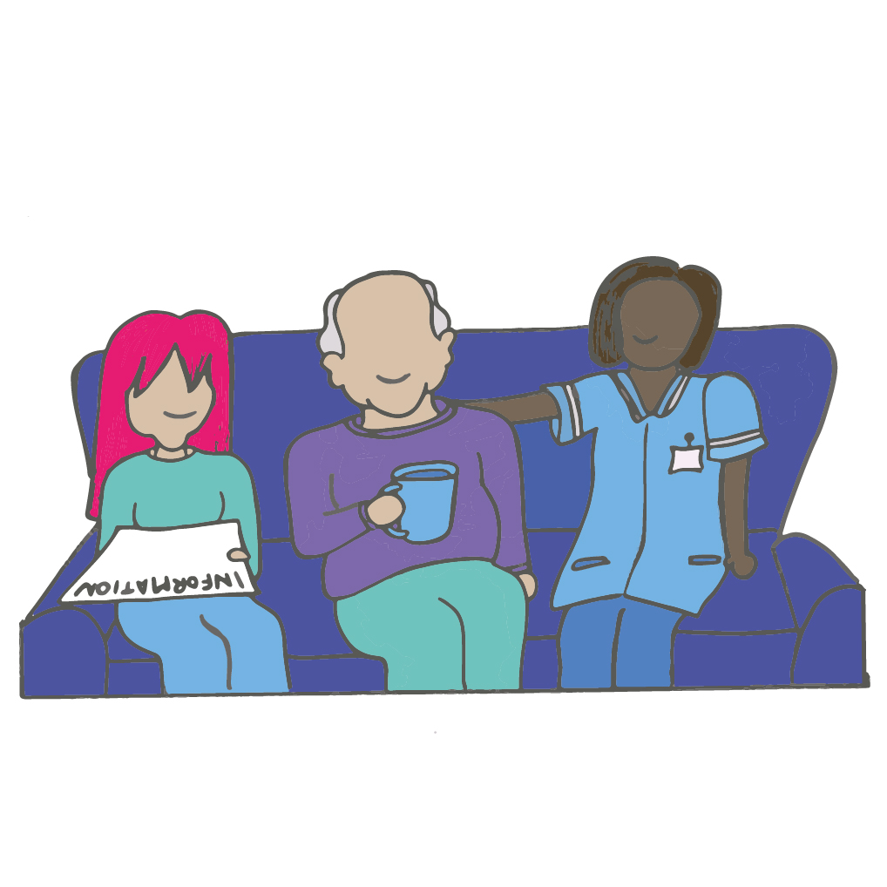
Your involvement
There is an on-going pledge to make
sure that people living with dementia
and their carers are listened to and involved in making these commitments become a reality.
We want to set clear outcomes so that we know if we are getting it right for people affected by dementia. These will be based on what people living with dementia and their carers tell us are important to them. We want to hear what you think about these commitments, how you think we might achieve them as a city, and how we will know when we are getting things right for people living with dementia.

Slide 6
Our Commitments
Sheffield will become a dementia friendly city.
We will ensure preventative health becomes an integral part of the dementia work.
We will improve access to the diagnosis of the diseases that cause dementia at the earliest possible stage for the people of Sheffield.

Slide 7
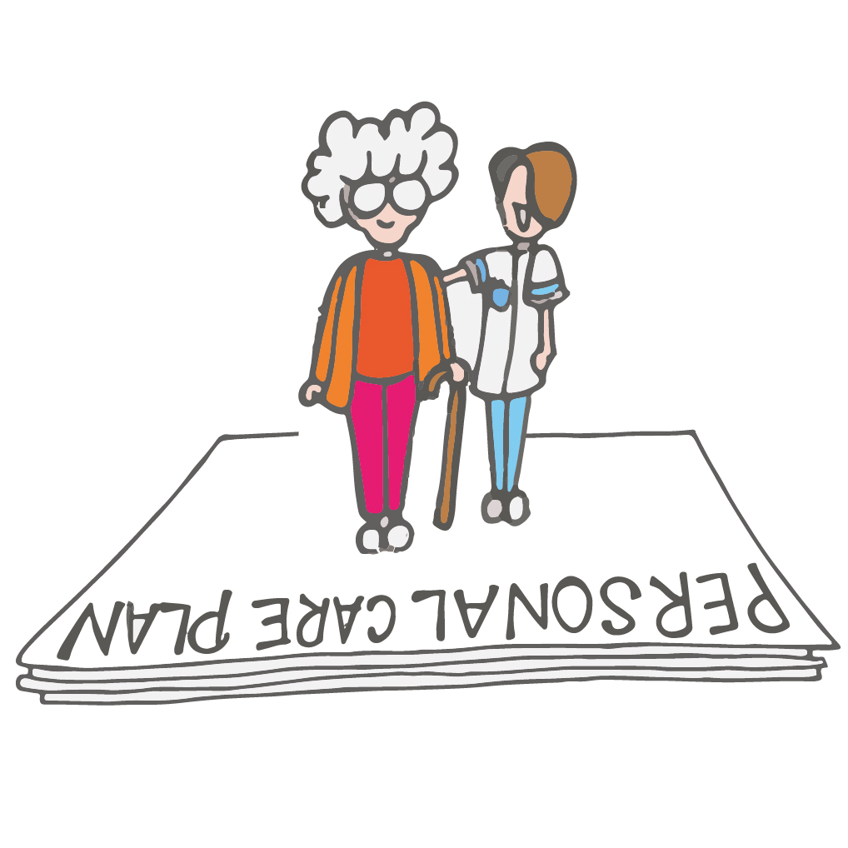
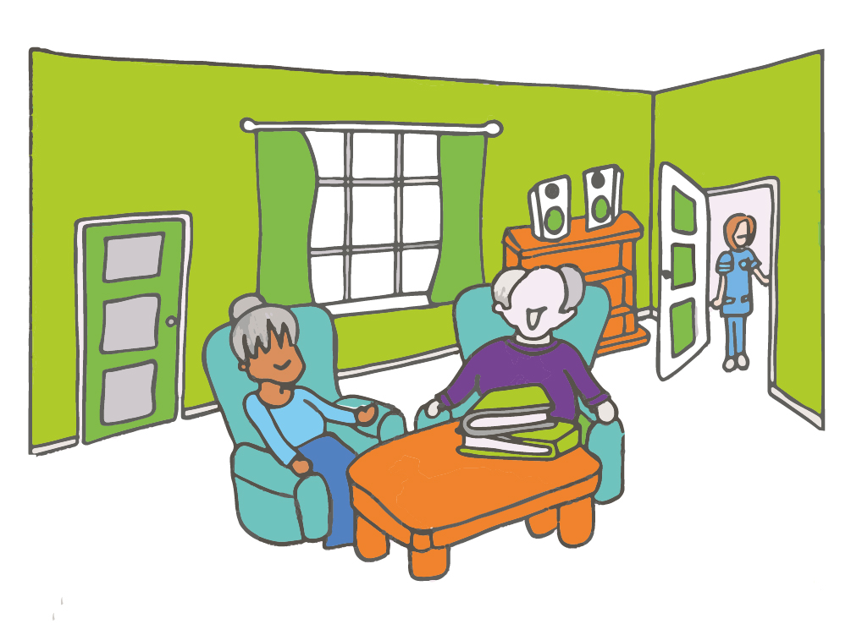
Our Commitments
Support for people with dementia in Sheffield will be more personalised, local and accessible to help people to remain independent for as long as possible.
We will provide high quality support to families and carers of people with dementia in Sheffield.
Sheffield will continue to provide out of hospital emergency assessments and short term care when people need it and in the most appropriate setting.

Slide 8
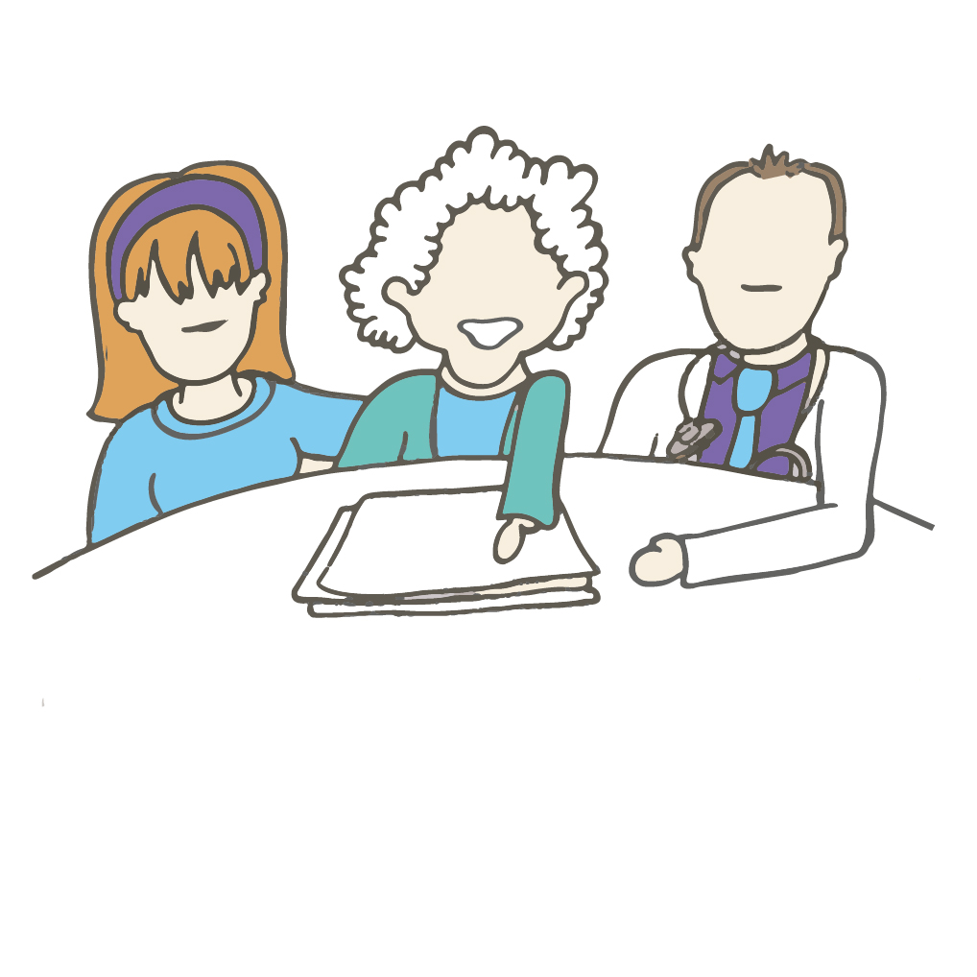
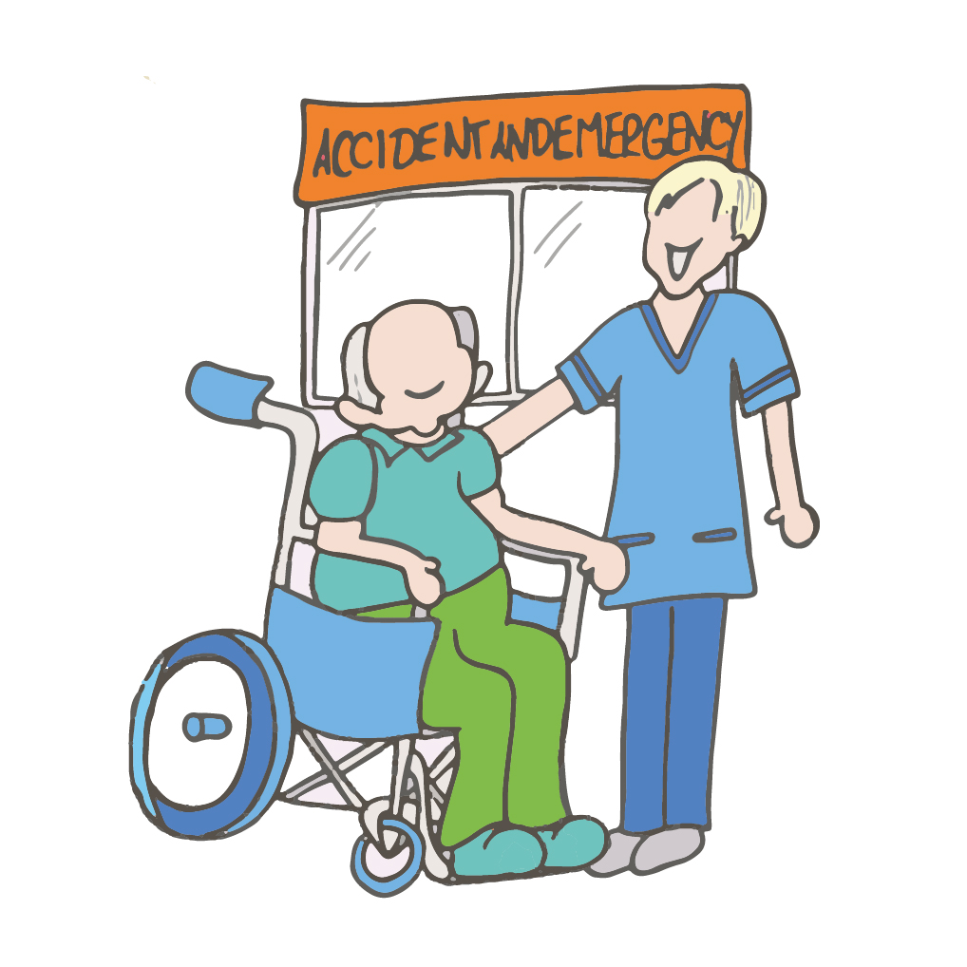
Our Commitments
Sheffield will continue to provide specialist inpatient assessment and treatment for people who are unable to receive care in their own homes.
We will make sure that more people get access to personalised, good quality palliative and end of life care when they need it.
We will improve care for people with dementia attending A&E and those admitted to Sheffield Teaching Hospitals.

Slide 9
Our Commitments
Care homes will take account of the needs of people with dementia.
We will support the clinical and non-clinical research community in Sheffield.
We will provide guidance to clinicians in relation to the best medicines for dementia, including when to initiate and review medication.
We will monitor the strategy and the implementation plan supporting it.

Slide 10
Questions
How will we know that we are getting it right for people living with dementia?
What would good dementia support look like to you?
What do you think the priorities should be in the first 1-2 years?
Are there any barriers to making these commitments happen, and how can they be overcome?
Is anything missing?

Slide 11
How you can have your say
Online survey - www.surveymonkey.com/r/SheffieldDementia
Fill out a freepost paper survey
Email us at sheccg.engagementactivity@nhs.net
Call us and leave a message on 0114 305 4609

